Slide 1




Supporting carers’ mental health
Synthesis of research on factors affecting family carers’ psychological wellbeing
Gunn Grande University of Manchester
Tracey Shield, Kerin Bayliss, Christine Rowland, Danielle Harris
Alison Wearden, Maria Panagioti, Alex Hodkinson, Penny Bee, Morag Farquhar (UEA)
Jackie Flynn, Lesley Goodburn, Margaret Booth, David Cotterill, Cederic Knipe
https://arc-gm.nihr.ac.uk/carer-project-

Slide 2
Background
Family carers provide crucial support to those nearing end of life (EOL)
This can have considerable impact on carers’ own health, particularly their mental health
Important to help carers stay in good mental health both to support them and to support the patient
A lot of research evidence on factors affecting carers’ mental health, but needed to be synthesised to be useful

Slide 3
Evidence synthesis
Aims
To synthesise what is known about factors affecting carers’ mental health during EOL caregiving
Gather findings from all research 2009-2019
  Qualitative: carers’ own accounts
  Quantitative: numbers data on factors associated with better or worse carers health
  Trials: interventions that improved mental health
Summarise and translate into accessible information for practitioners, commissioners, policy makers, carer organisations

Slide 4
Carer Review Advisory Panel (RAP)
Aim
To ensure findings were meaningful from carers’ perspective
Do summaries of findings reflect their experience?
Are they presented in a format that is easy to understand?
Additional RAP aim
To develop Carer Recommendations based on findings

Slide 5
The process
33 qualitative, 63 quantitative and 13 intervention studies identified on factors linked to carer mental health during EOL caregiving
Qualitative carer accounts summarised into themes
Quantitative and intervention findings integrated into these themes
Review Advisory Panel (RAP) meetings:
Carer Chair, 4-5 carers and 3 researchers
9 meetings, mainly on Zoom due to Covid

Slide 6
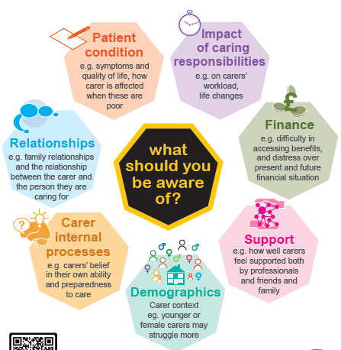
Factors linked to carer mental health
Read full reports at https://arc-gm.nihr.ac.uk/carer-project-

Slide 7
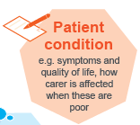
Patient condition
The patient’s physical and cognitive decline impacted on carers’ mental health
Worse patient psychological symptoms were linked to worse carer mental health, and better patient quality of life to better carer mental health
“As soon as I see him struggling or … being depressed, everything in my world, my own quality of life, comes to a screeching halt.”

Slide 8

Support
The quality of formal support (e.g. coordination of care, communication, empathy) was emphasised by carers as affecting their mental health
“You’re just sent home to deal with it on your own, find your own solutions.”
“I think sometimes one hand doesn’t know what the other hand is doing … “
Quality of informal support was also related to carers’ mental health

Slide 9

Impact of caring responsibilities
Greater lifestyle adjustments, demands of caregiving, and level of carer burden were related to worse carer mental health
“It’s the shrinking of your world that I find the hardest (…) The social aspect of it is the hardest because most people get a lot of their social life at work or from doing other things.…”
“Yes, you get fed up … it’s going on a long time and … yes. I think we do feel that the pressure is getting to us really. It has been hard …”

Slide 10
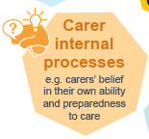
Carer internal processes
Loss of self-determination, autonomy and control, lack of confidence in caring role and adjusting to transitions, relate to worse mental health
“there’s something that has come into your life that is both robbing you and robbing your wife..”
“It’s actually quite frightening, that you’re in charge of somebody so sick and you don’t know what to do for them and yet you know they need serious medical help.”
Better self-efficacy, preparedness and mastery associated with better mental health

Slide 11
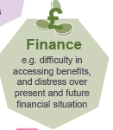


Finance, relationships and demographics
The impact of caregiving on costs, finances and work was mainly emphasised by carers themselves as relating to their mental health
Relationship changes in roles and quality of relationship with the patient may matter
Some demographic groups may be more vulnerable, e.g. younger carers and women, but results unclear

Slide 12
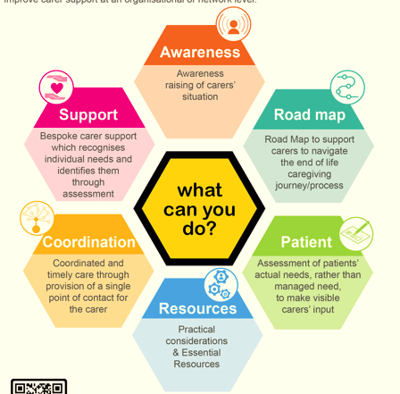
Carer Recommendations
Read full recommendations in report at https://arc-gm.nihr.ac.uk/carer-project-

Slide 13
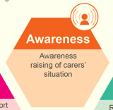
Awareness raising
Two components needed to ensure services are communicated to carers in a timely manner to meet their needs:
Make carers aware of support services available to themselves and person cared for
Raise awareness among practitioners to address impact of caregiving on carers

Slide 14
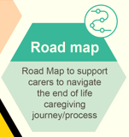
Road map
Provide carers with a ‘road map’ with information to prepare and support them to navigate each stage of caregiving and bereavement
Needs to be holistic and include
Help available locally
How to access specialist equipment and services for home care
Practical advice, including legal, financial, services
List of relevant contact numbers, websites and email addresses

Slide 15
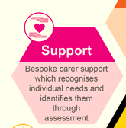
Support
Bespoke support which recognises the carer has needs and identifies them through assessment
Holistic support tailored to individual carers through
Use of appropriate assessment tools
Comprehensive assessment (including medical, personal, social), considering actual needs rather than just what services can offer
Taking into account carer’s personal circumstances

Slide 16
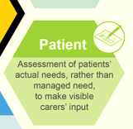
Patient assessment
Patients should be assessed for their ‘actual’ needs as opposed to their ‘managed’ needs, to avoid overestimating patients’ capabilities, ensure that their dependency on carers’ support is fully recognised, and ensure carers feel able to manage caregiving tasks
Assessment should be standardized across services and provide a comprehensive patient assessment

Slide 17
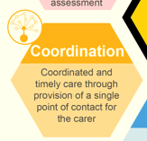
Coordinated and timely care
Provide carer access to a key worker as a single point of contact, to ensure patient care is timely, continuous, and that both carer and patient care are coordinated.
This support should include:
Comprehensive needs assessment
Help with administrative tasks, e.g. forms
Follow up by relevant services
Advocacy support to help articulate need

Slide 18
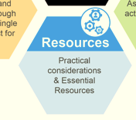
Practical considerations & Essential Resources
Must self-declare to be recognised as carer which some find difficult
May live in different household to patient
Time is short and therefore of the essence
Minimum requirements:
Meeting basic physical needs
Ensure sufficient finances
Easily accessible equipment when needed
Practical advice, including legal and financial

Slide 19
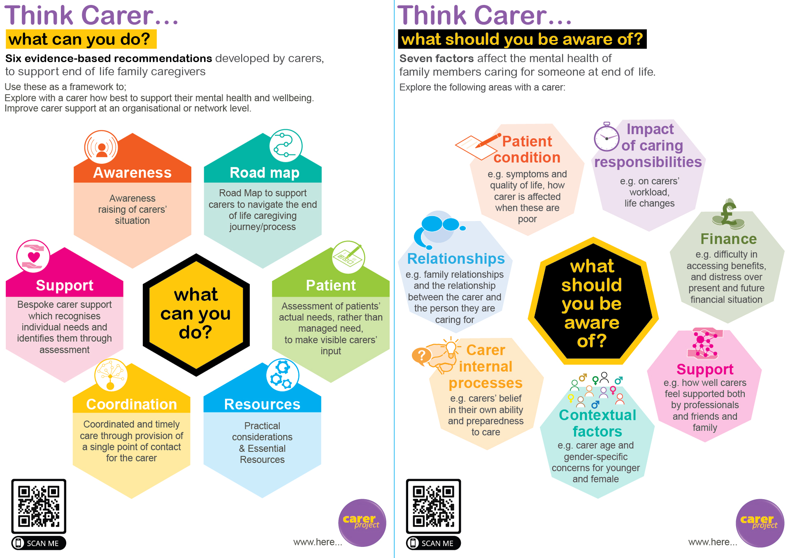
Project resources

Slide 20

Project website https://arc-gm.nihr.ac.uk/carer-project-
        Publications
        Findings in graphic and table formats
        Blogs and Podcasts

Slide 21

Thank you
Further information available at
https://arc-gm.nihr.ac.uk/carer-project-
Gunn.grande@Manchester.ac.uk

